Slide 1
ECEN 350 Electronic Devices and Circuits
CMOS Latch-up Final Exam Review

Slide 2
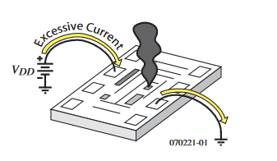
CMOS Latch-up
CMOS is susceptible to a damaging condition called latch-up for applied voltages greater than the positive supply voltage or more negative than the negative supply voltage, which is often Gnd.
Have to be very careful with systems having
different supply voltages.
Power supply sequencing may be necessary.
Ideally want all inputs to an IC equal to zero until
the power supply for that IC has stabilized at the
desired voltage.
Must be careful when powering up IC’s so that V_{DD}
is turned on and stabilized before applying a voltage to an input or output.
May need to keep some devices in Reset until power supplies stabilize.
Current limiting resistors on vulnerable inputs may be wise.

Slide 3
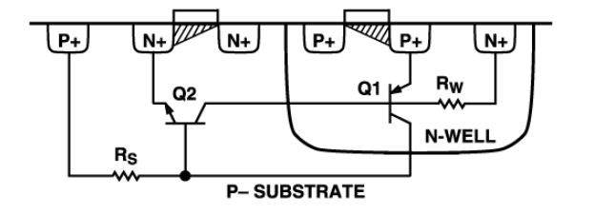
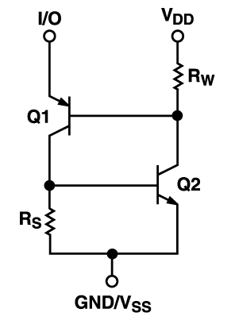
CMOS Latch-up (Continued)
See – “Winning the Battle Against Latch-up in CMOS Analog Switches” by Catherine Redmond, Analog Devices.
Q1, Q2, Rw and Rs are parasitic devices.
Turning on of Q1 results in turning on of Q2, which then connects V_{DD} to Gnd through fairly low resistance.
Q1 and Q2 both turned on is referred to as latch-up, and requires powering everything down to clear the latched-up condition.
If V_{DD} is not current limited, die heating often destroys the IC in latch-up.
Must be careful when powering up IC’s so that V_{DD} is up before applying a voltage to an input or output.
Typical CMOS Cross-Section
Equivalent Circuit

Slide 4
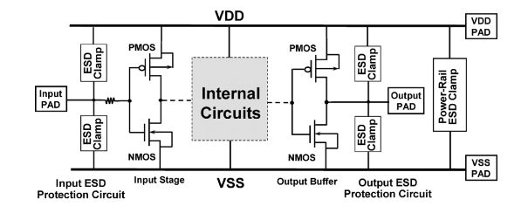
CMOS Latch-up and ESD - Electrostatic Discharge
CMOS Latch-up
Because of latch-up, you have to be careful when powering up systems with CMOS ICs on the PCB.
May need to keep some devices in Reset until supplies stabilize.
Current limiting resistors on vulnerable inputs can prevent latch-up, which is current triggered.
ESD – Electrostatic Discharge
Unprotected MOSFET gates are extremely
vulnerable to ESD because of thin gate oxide.
ESD damage was a major problem in the
early days of MOSFETs.
Modern discrete MOSFETs and CMOS ICs
include protection circuitry to help mitigate
ESD damage during handling and installation.
CMOS has only been successful because of persistence in solving the resulting latch-up and ESD problems.

Slide 5
ECEN 350 – Topics
Semiconductor Physics
Rectifiers
Zeners
Diodes
BJTs
MOSFETs
CMOS
LEDs
Transistor Biasing
Small-Signal Analysis
Amplifier Gain Stages
Op-Amps
Frequency Response

Slide 6
Final Exam Review
Final test has 25 questions covering material discussed in class since midterm.
Auto-graded test with many short answers, most requiring calculations, to be completed within 4 hours upon starting.
Test is an open book, open note out-of-class test on I-Learn. Power Point class slides, along with homework and lab keys published during this semester can also be referenced. But -- You may not communicate with anyone except the instructor regarding how to answer these test questions. This means that pursuing answers on the internet is not allowed for these test questions, as that is considered communicating with others.
This final test counts for 12.5% of overall grade, as did the midterm.
Test Suggestions:
1.) While you have a few days during which to take the test, once it is open it is to be completed within 4 hours.
2.) Know how to do HWs, as several questions similar to HW problems.
3.) Test focuses on material discussed in class, along with HW and Labs.
4.) If you understand the HWs and labs, you should do well on this test.

Slide 7
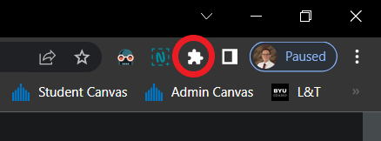
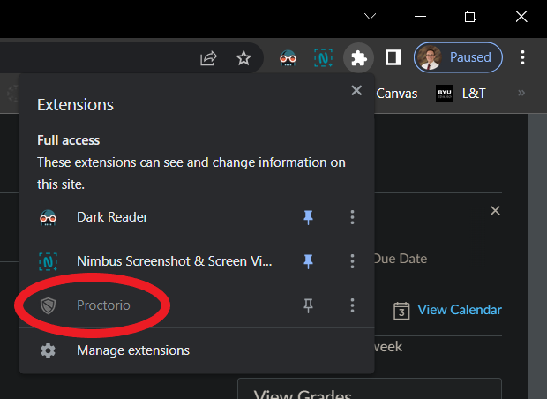

Remote Proctoring - Proctorio
Before Your Exam
Download the Proctorio Chrome extension https://getproctorio.com/.
Use Chrome and update your browser to the latest version and clear cache/cookies before the test. https://help.crelate.com/en/articles/4120395-clearing-your-cache-updating-google-chrome.
Charge or plug-in your computer, and eliminate interruptions.
If you are asked for a code to take the exam, delete and re-install the Proctorio Chrome extension https://getproctorio.com/.
During Your Exam
Once started, you have 4 hours to complete the exam.
You can leave the room during the exam, although try and minimize walking around.
If you experience technical difficulties, click the shield icon (browser bar, upper right).
Next, click on the Proctorio Extension icon.

Slide 8
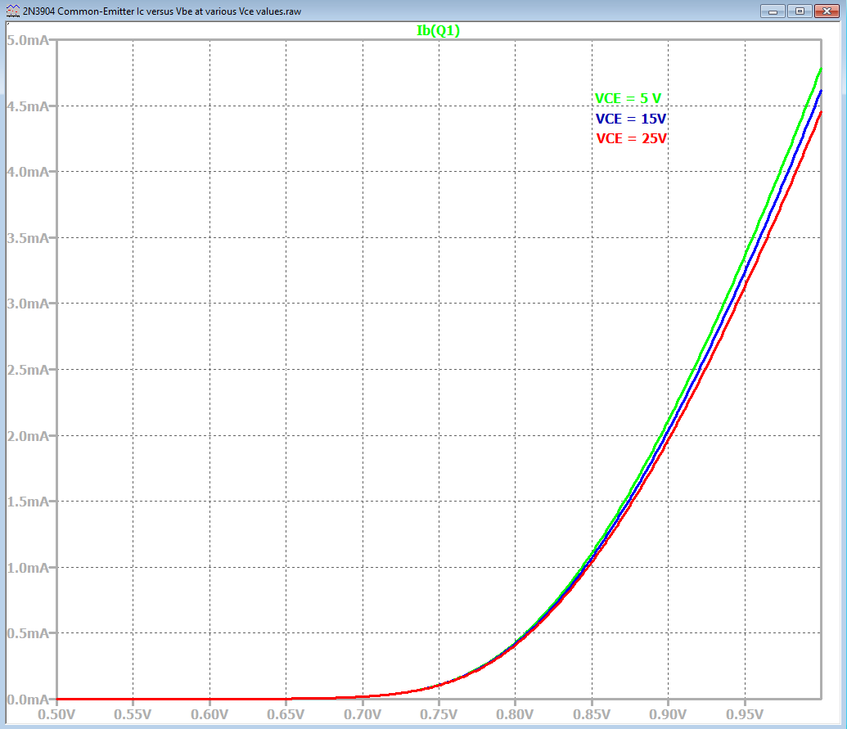
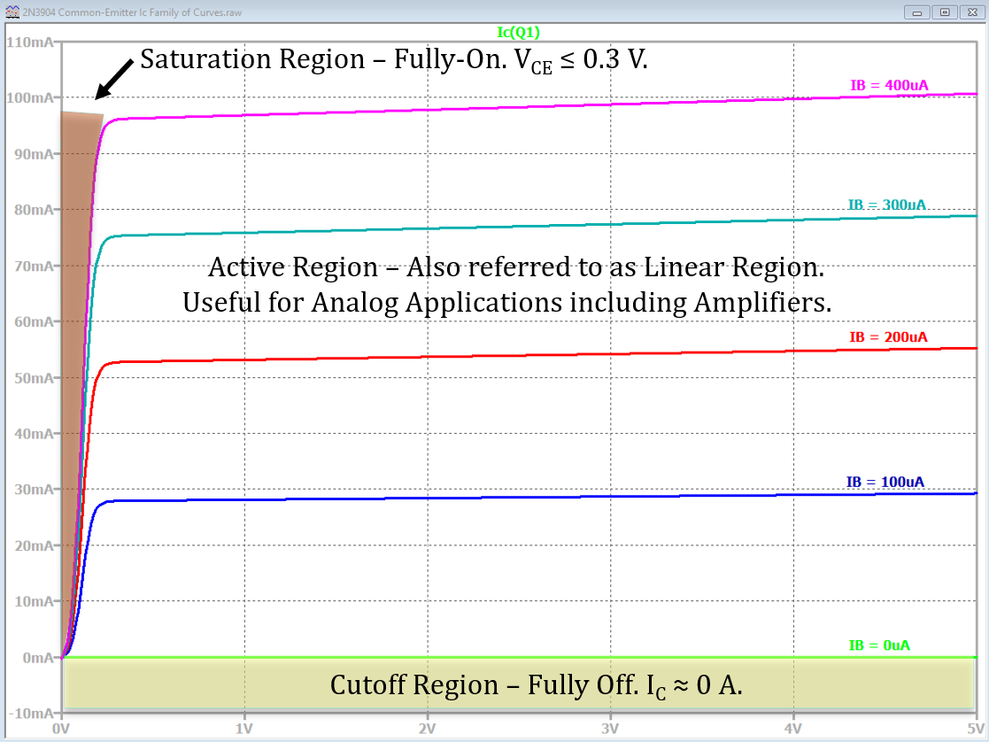
npn Common-Emitter (CE) I-V Characteristics Summary
In active region the Base current I_{B} is fairly
independent of Collector-to-Emitter voltage as shown
in adjacent graph.
Hence, since I_{C} = βI_{B}, in the active region, Collector current is
also fairly independent of Collector-to-Emitter voltage.
Collector current versus Collector-to-Emitter
voltage for several different Base current values
results in the adjacent family of I_{C} versus V_{CE} curves.
Three regions of operation, i.e. cutoff, active
and saturation, are illustrated in adjacent family
of curves.
Saturation occurs when the Base-Emitter
junction is forward biased and the Collector-Base
junction becomes slightly forward biased at
V_{BC} ≥ 0.4 V, corresponding to V_{CE} ≤ 0.3 V, for V_{BE} = 0.7 V.

Slide 9
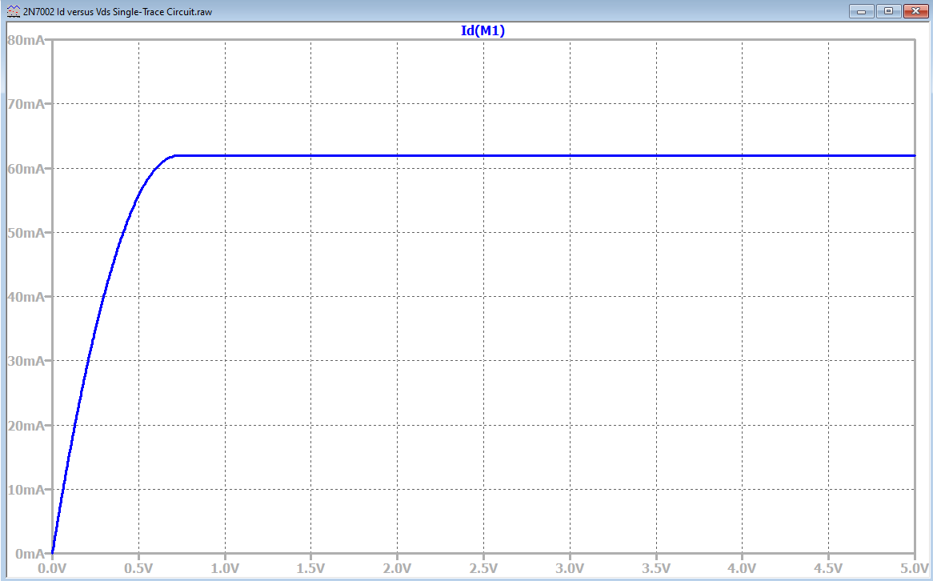
MOSFET Ohmic and Saturation Regions (Continued)
MOSFETs are operated in the Ohmic and cutoff regions for on/off switching applications.
MOSFETs are operated in the Transistor
Saturation or Active region for analog
applications such as current sources and
amplifiers.
MOSFETs behave like a non-linear resistor
in the Ohmic region and like voltage dependent
current source in the Saturation or Active region.
Hence MOSFET Ohmic region corresponds to
BJT Saturation region, and MOSFET Saturation
region corresponds to BJT Active region.
This is inconsistent and confusing, but like
other conventions, such as conventional current
flow, we learn to live with it.
We could just use our Author’s vernacular,
in which he refers to MOSFETs saturation as analogous to BJT circuit saturation, but that could cause unfortunate misunderstandings when talking to MOSFET oriented companies such as Micron, and/or On-Semiconductor.
MOSFET Transistor Saturation or Active Region operation can be approximated as a current source that is dependent upon V_{GS}.
Ohmic or Triode
Region
Transistor Saturation or Active Region

Slide 10
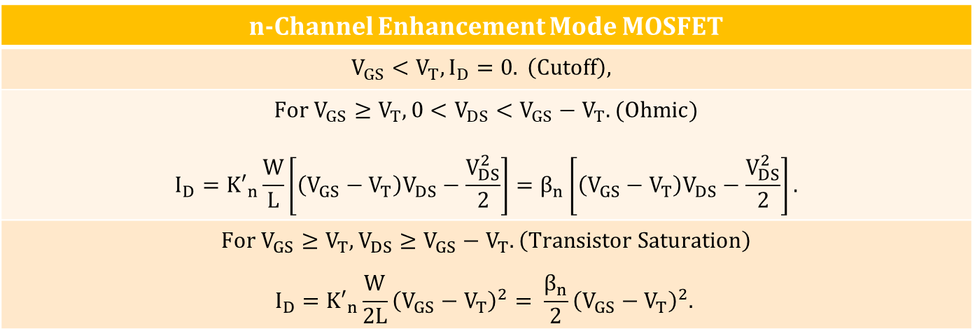
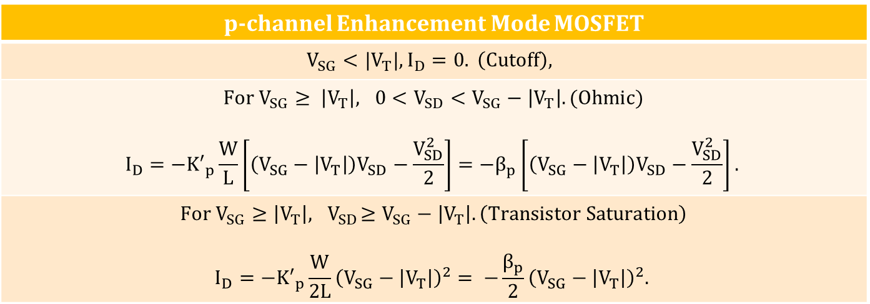
Sah’s Equations for Enhancement Mode MOSFETs
n-Channel Enhancement Mode MOSFET
$$V_{GS}<V_{T}, I_{D}=0. \left(Cutoff\right),$$
$For V_{GS}≥V_{T}, 0<V_{DS}<V_{GS}−V_{T}. (Ohmic)$ $$I_{D}={K′}_{n}\frac{W}{L}\left[\left(V_{GS}−V_{T}\right)V_{DS}−\frac{V_{DS}^{2}}{2}\right]=β_{n}\left[\left(V_{GS}−V_{T}\right)V_{DS}−\frac{V_{DS}^{2}}{2}\right].$$
$$For V_{GS}≥V_{T}, V_{DS}≥V_{GS}−V_{T}. \left(Transistor Saturation\right)$$ $$I_{D}={K′}_{n}\frac{W}{2L}{\left(V_{GS}−V_{T}\right)}^{2}= \frac{β_{n}}{2}{\left(V_{GS}−V_{T}\right)}^{2}.$$
p-channel Enhancement Mode MOSFET
$$V_{SG}<{|V}_{T}|, I_{D}=0. \left(Cutoff\right),$$
$For V_{SG}≥ \left|V_{T}\right|, 0<V_{SD}<V_{SG}−\left|V_{T}\right|. (Ohmic)$ $$I_{D}={−K′}_{p}\frac{W}{L}\left[\left(V_{SG}−\left|V_{T}\right|\right)V_{SD}−\frac{V_{SD}^{2}}{2}\right]={−β}_{p}\left[\left(V_{SG}−\left|V_{T}\right|\right)V_{SD}−\frac{V_{SD}^{2}}{2}\right].$$
$$For V_{SG}≥\left|V_{T}\right|, { V}_{SD}≥V_{SG}−\left|V_{T}\right|. \left(Transistor Saturation\right)$$ $$I_{D}={−K′}_{p}\frac{W}{2L}{\left(V_{SG}−\left|V_{T}\right|\right)}^{2}= −\frac{β_{p}}{2}{\left(V_{SG}−\left|V_{T}\right|\right)}^{2}.$$

Slide 11
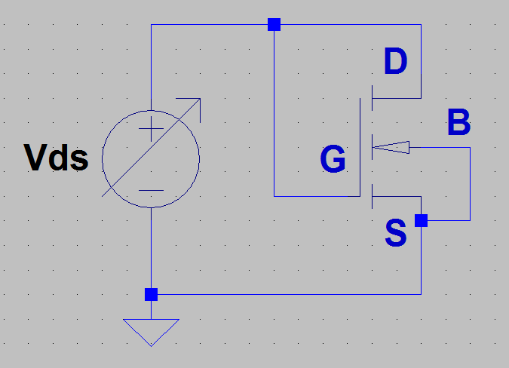
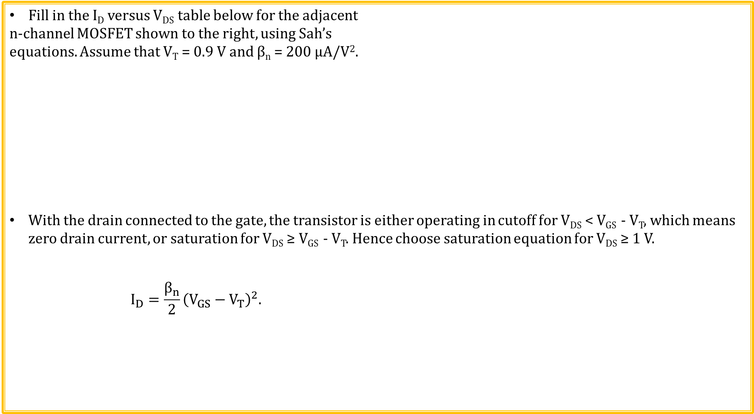
n-channel MOSFET Example 1
Fill in the I_{D} versus V_{DS} table below for the adjacent
n-channel MOSFET shown to the right, using Sah’s
equations. Assume that V_{T} = 0.9 V and β_{n} = 200 µA/V².
With the drain connected to the gate, the transistor is either operating in cutoff for V_{DS} < V_{GS} - V_{T}, which means zero drain current, or saturation for V_{DS} ≥ V_{GS} - V_{T}. Hence choose saturation equation for V_{DS} ≥ 1 V.
$$I_{D}=\frac{β_{n}}{2}{\left(V_{GS}−V_{T}\right)}^{2}.$$
V_{DS} (V) | I_{D}
0
1
2
3
4
5
V_{DS} (V) | I_{D}
0 | 0 µA
1 | 1 µA
2 | 121 µA
3 | 441 µA
4 | 961 µA
5 | 1.68 mA

Slide 12
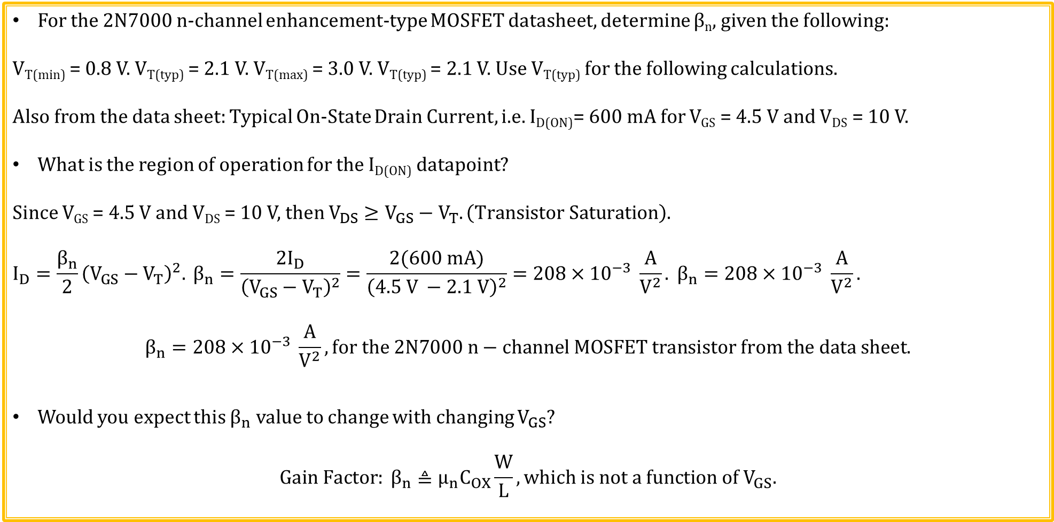
n-channel MOSFET Example 2
For the 2N7000 n-channel enhancement-type MOSFET datasheet, determine β_{n}, given the following:
V_{T(min)} = 0.8 V. V_{T(typ)} = 2.1 V. V_{T(max)} = 3.0 V. V_{T(typ)} = 2.1 V. Use V_{T(typ)} for the following calculations.
Also from the data sheet: Typical On-State Drain Current, i.e. I_{D(ON)}= 600 mA for V_{GS} = 4.5 V and V_{DS} = 10 V.
What is the region of operation for the I_{D(ON)} datapoint?
Since V_{GS} = 4.5 V and V_{DS} = 10 V, then $V_{DS}≥V_{GS}−V_{T}. \left(Transistor Saturation\right)$.
$$I_{D}=\frac{β_{n}}{2}{\left(V_{GS}−V_{T}\right)}^{2}. β_{n}=\frac{2I_{D}}{{\left(V_{GS}−V_{T}\right)}^{2}}=\frac{2(600 mA)}{{\left(4.5 V −2.1 V\right)}^{2}}=208×{10}^{−3} \frac{A}{V^{2}}. β_{n}=208×{10}^{−3} \frac{A}{V^{2}}.$$
$$β_{n}=208×{10}^{−3} \frac{A}{V^{2}}, for the 2N7000 n−channel MOSFET transistor from the data sheet.$$
Would you expect this $β_{n}$ value to change with changing $V_{GS}$?
$$Gain Factor: β_{n}≜μ_{n}C_{OX}\frac{W}{L}, which is not a function of V_{GS}.$$

Slide 13
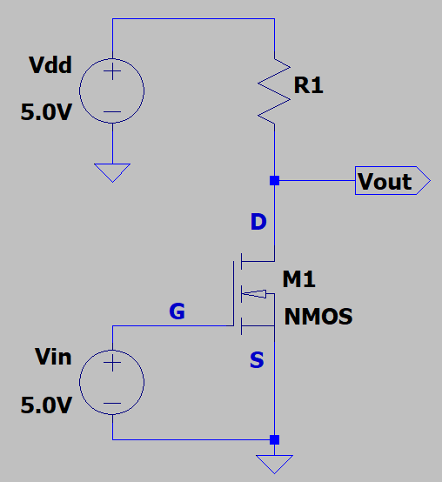
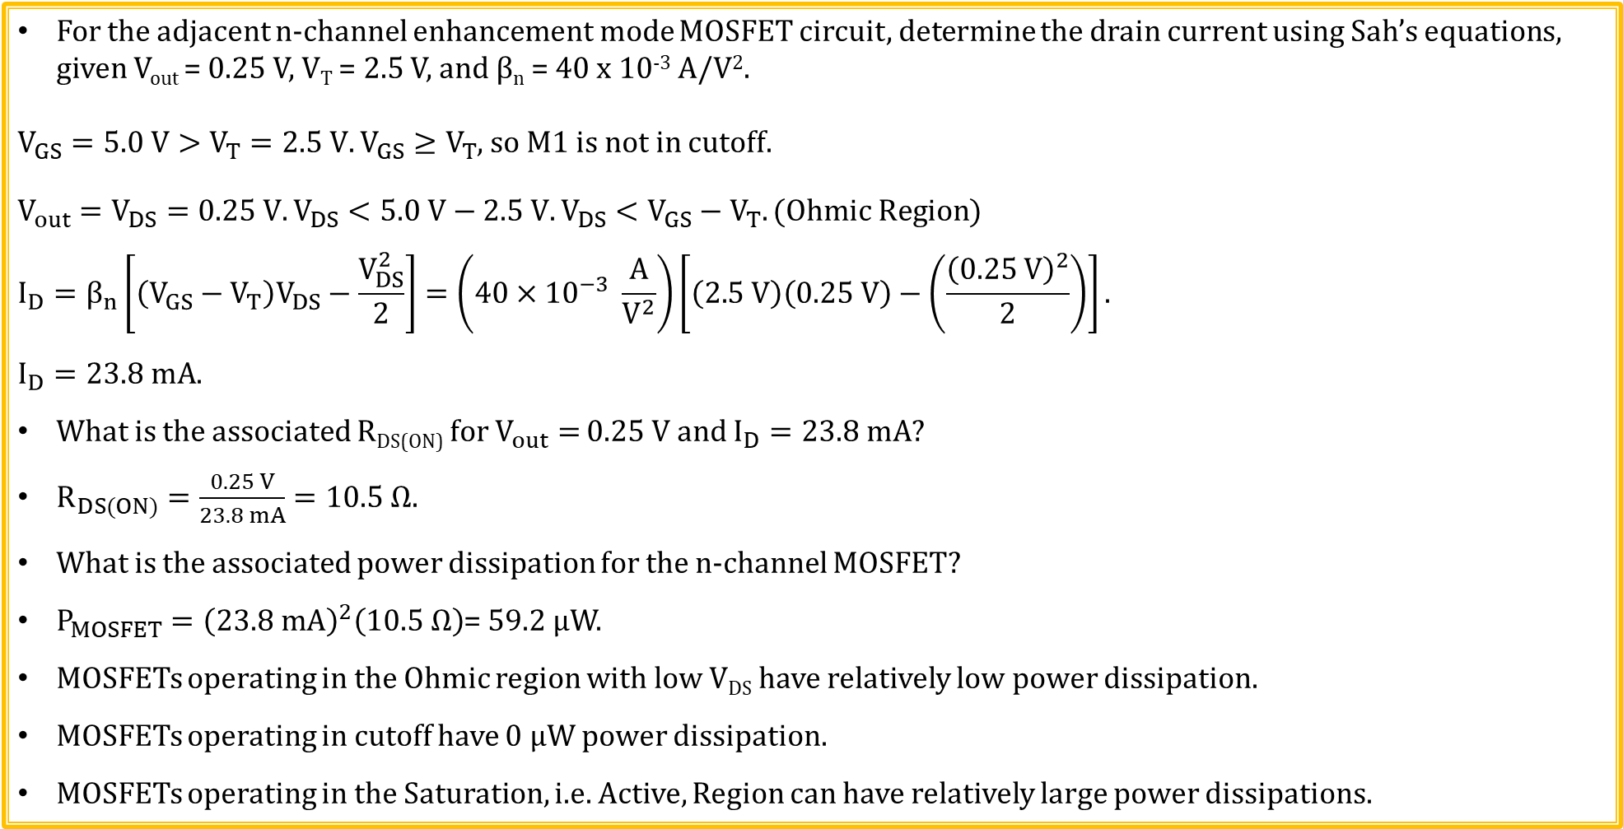
n-channel MOSFET Example 3
For the adjacent n-channel enhancement mode MOSFET circuit, determine the drain current using Sah’s equations, given V_{out} = 0.25 V, V_{T} = 2.5 V, and β_{n} = 40 x 10⁻³ A/V².
$V_{GS}=5.0 V>V_{T}=2.5 V. V_{GS}≥V_{T}$, so M1 is not in cutoff.
$V_{out}=V_{DS}=0.25 V.V_{DS}<5.0 V−2.5 V. V_{DS}<V_{GS}−V_{T}. (Ohmic Region)$
$$I_{D}=β_{n}\left[\left(V_{GS}−V_{T}\right)V_{DS}−\frac{V_{DS}^{2}}{2}\right]=\left(40×{10}^{−3} \frac{A}{V^{2}}\right)\left[\left(2.5 V\right)\left(0.25 V\right)−\left(\frac{{\left(0.25 V\right)}^{2}}{2}\right)\right].$$
$$I_{D}=23.8 mA.$$
What is the associated R_{DS(ON)} for $V_{out}=$ 0.25 V and $I_{D}=23.8 mA?$
$R_{DS(ON)}=\frac{0.25 V}{23.8 mA}=10.5 Ω.$
What is the associated power dissipation for the n-channel MOSFET?
$P_{MOSFET}={\left(23.8 mA\right)}^{2}\left(10.5 Ω\right)$= 59.2 µW.
MOSFETs operating in the Ohmic region with low V_{DS} have relatively low power dissipation.
MOSFETs operating in cutoff have 0 µW power dissipation.
MOSFETs operating in the Saturation, i.e. Active, Region can have relatively large power dissipations.

Slide 14
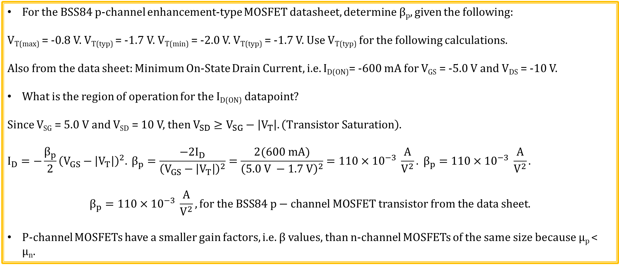
p-channel MOSFET Example 1
For the BSS84 p-channel enhancement-type MOSFET datasheet, determine β_{p}, given the following:
V_{T(max)} = -0.8 V. V_{T(typ)} = -1.7 V. V_{T(min)} = -2.0 V. V_{T(typ)} = -1.7 V. Use V_{T(typ)} for the following calculations.
Also from the data sheet: Minimum On-State Drain Current, i.e. I_{D(ON)}= -600 mA for V_{GS} = -5.0 V and V_{DS} = -10 V.
What is the region of operation for the I_{D(ON)} datapoint?
Since V_{SG} = 5.0 V and V_{SD} = 10 V, then $V_{SD}≥V_{SG}−\left|V_{T}\right|. \left(Transistor Saturation\right)$.
$$I_{D}=−\frac{β_{p}}{2}{\left(V_{GS}−\left|V_{T}\right|\right)}^{2}. β_{p}=\frac{−2I_{D}}{{\left(V_{GS}−\left|V_{T}\right|\right)}^{2}}=\frac{2(600 mA)}{{\left(5.0 V −1.7 V\right)}^{2}}=110×{10}^{−3} \frac{A}{V^{2}}. β_{p}=110×{10}^{−3} \frac{A}{V^{2}}.$$
$$β_{p}=110×{10}^{−3} \frac{A}{V^{2}}, for the BSS84 p−channel MOSFET transistor from the data sheet.$$
P-channel MOSFETs have a smaller gain factors, i.e. β values, than n-channel MOSFETs of the same size because µ_{p} < µ_{n}.

Slide 15
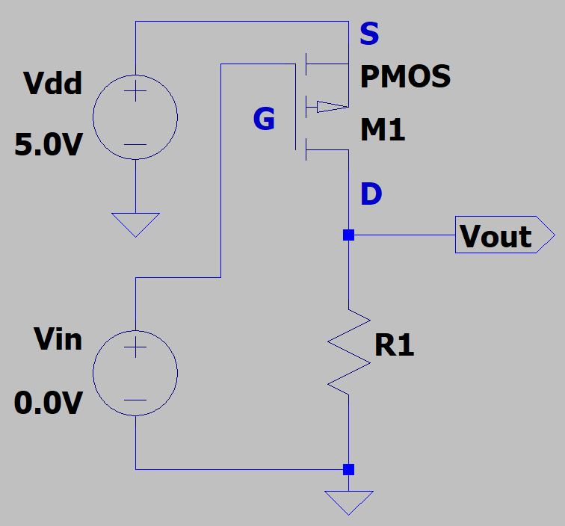
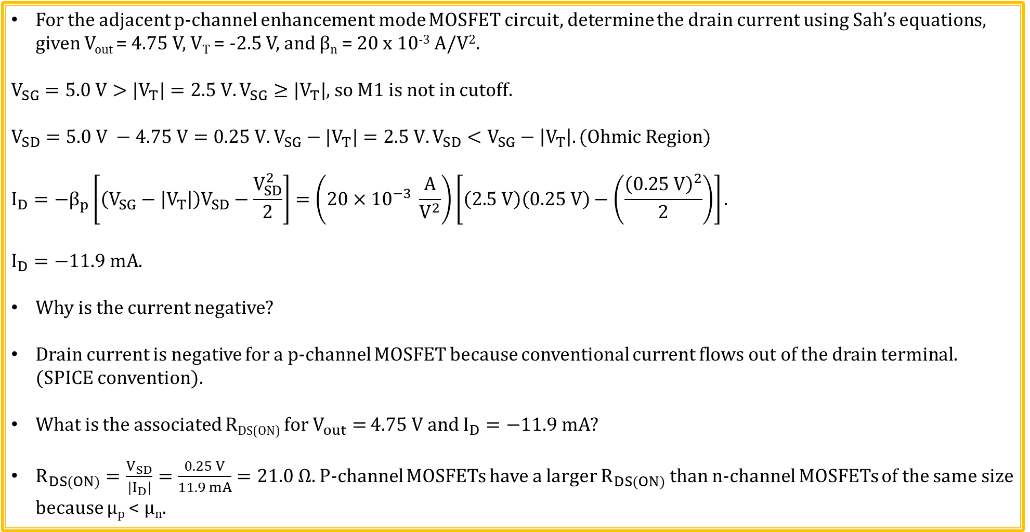
p-channel MOSFET Example 2
For the adjacent p-channel enhancement mode MOSFET circuit, determine the drain current using Sah’s equations, given V_{out} = 4.75 V, V_{T} = -2.5 V, and β_{n} = 20 x 10⁻³ A/V².
$V_{SG}=5.0 V>{|V}_{T}|=2.5 V. V_{SG}≥{|V}_{T}|$, so M1 is not in cutoff.
$$V_{SD}=5.0 V −4.75 V=0.25 V. V_{SG}−{|V}_{T}|=2.5 V.V_{SD}<V_{SG}−\left|V_{T}\right|. (Ohmic Region)$$
$$I_{D}={−β}_{p}\left[\left(V_{SG}−\left|V_{T}\right|\right)V_{SD}−\frac{V_{SD}^{2}}{2}\right]=\left(20×{10}^{−3} \frac{A}{V^{2}}\right)\left[\left(2.5 V\right)\left(0.25 V\right)−\left(\frac{{\left(0.25 V\right)}^{2}}{2}\right)\right].$$
$$I_{D}=−11.9 mA.$$
Why is the current negative?
Drain current is negative for a p-channel MOSFET because conventional current flows out of the drain terminal. (SPICE convention).
What is the associated R_{DS(ON)} for $V_{out}=$ 4.75 V and $I_{D}=−11.9 mA?$
$R_{DS(ON)}=\frac{V_{SD}}{{|I}_{D}|}=\frac{0.25 V}{11.9 mA}=21.0 Ω.$P-channel MOSFETs have a larger $R_{DS(ON)}$ than n-channel MOSFETs of the same size because µ_{p} < µ_{n}.

Slide 16
Test Time – Just for Fun. No Points.

Slide 17
BJT Test
What is largest current in a bipolar transistor operating in the active region?
1. Emitter Current.
2. Base Current.
3. Collector Current.
Answer: 1. Emitter Current since I_{E} = I_{C} + I_{B}.

Slide 18
BJT Test (Continued)
The arrow in the transistor symbol defines the direction of conventional current flow for which of the following terminals?
1. Emitter.
2. Base.
3. Collector.
Answer: 1. Emitter, which then also defines the direction for base and collector currents since I_{E} = I_{C} + I_{B}.

Slide 19
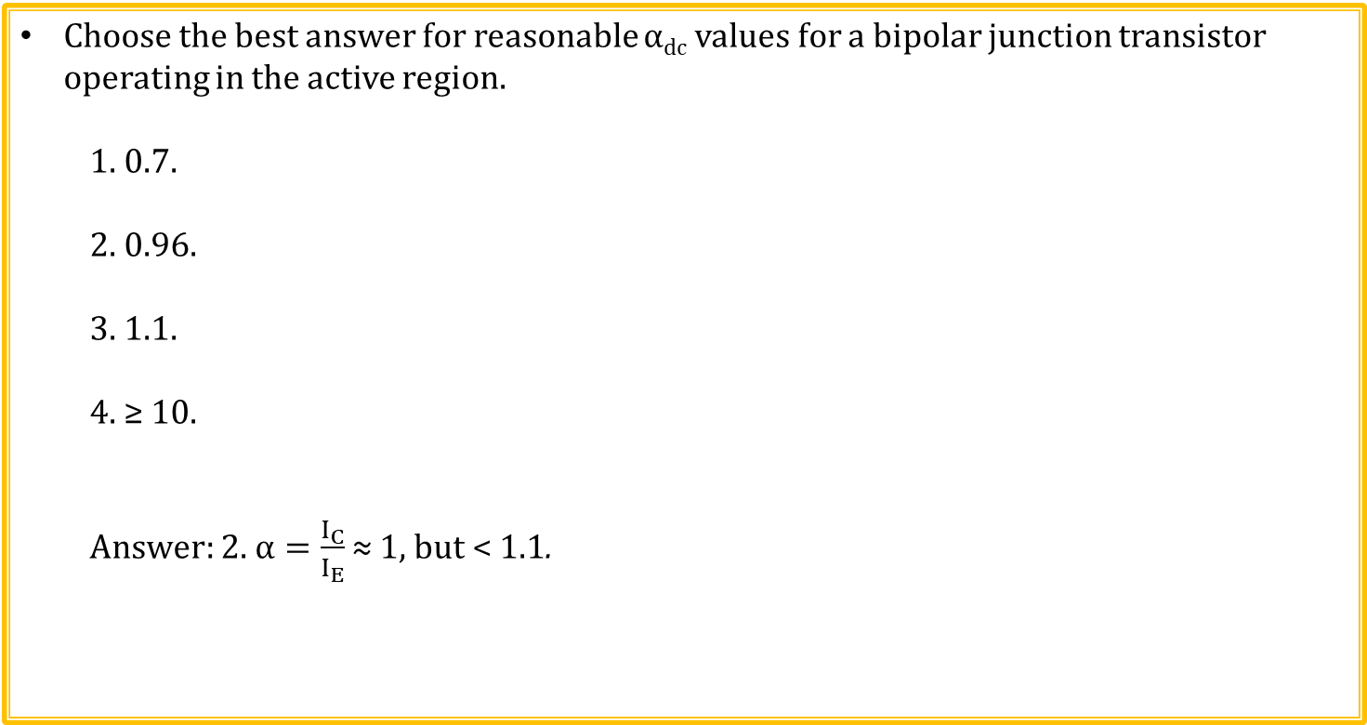
BJT Test (Continued)
Choose the best answer for reasonable $α$_{dc} values for a bipolar junction transistor operating in the active region.
1. 0.7.
2. 0.96.
3. 1.1.
4. ≥ 10.
Answer: 2. $α=\frac{I_{C}}{I_{E}}$ ≈ 1, but < 1.1.

Slide 20
BJT Test (Continued)
In the active region of a bipolar transistor what are the bias conditions
for the Base-Emitter and Collector-Base junctions?
1. Forward, Forward.
2. Forward, Reverse.
3. Reverse, Forward.
4. Reverse, Reverse.
Answer: 2. Base-Emitter forward biased and Collector-Base junction
reverse biased for active region.

Slide 21
BJT Test (Continued)
As a 2nd approximation for hand calculations, the base-to-emitter voltage of a bipolar junction transistor operating in the saturation or active regions can be assumed to be what voltage?
1. 0.0 V.
2. 0.3 V.
3. 0.7 V.
4. Not enough information.
Answer: 3. 0.7 V.

Slide 22
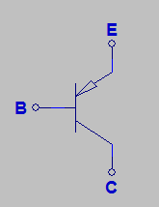
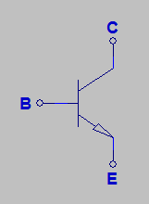
BJT Test (Continued)
Is the following transistor symbol for an npn or pnp transistor?
1. npn.
2. pnp.
Answer: 2. pnp transistor since arrow is pointing in, whereas
the arrow in an npn transistor is not pointing in.

Slide 23
BJT Test (Continued)
What is smallest current in a bipolar transistor operating in the active region?
1. Emitter Current.
2. Base Current.
3. Collector Current.
Answer: 2. Base Current since I_{E} ≈ I_{C} and I_{B} << I_{C}.

Slide 24
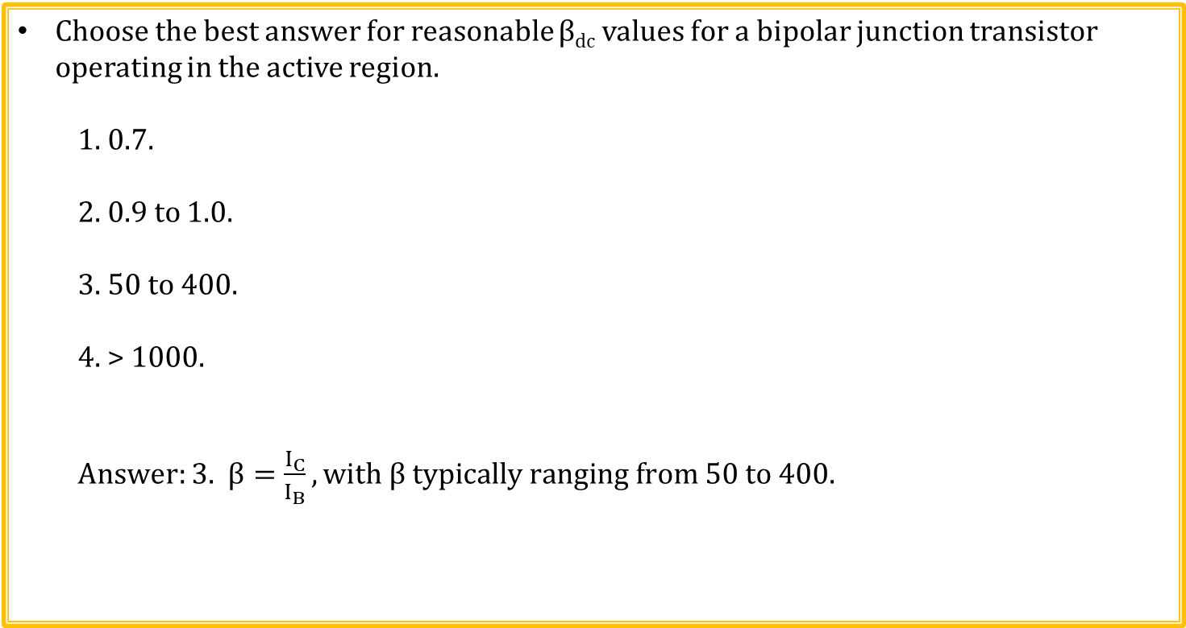
BJT Test (Continued)
Choose the best answer for reasonable β_{dc} values for a bipolar junction transistor operating in the active region.
1. 0.7.
2. 0.9 to 1.0.
3. 50 to 400.
4. > 1000.
Answer: 3. $β=\frac{I_{C}}{I_{B}}, with β typically ranging from 50 to 400.$

Slide 25
MOSFET Test Question 1
Choose the best answer for reasonable V_{T} values for an n-channel enhancement mode MOSFET.
1. 10 mV.
2. 1.0 V.
3. 12 V.
4. 60 V.
Answer: 2. 1.0 V. N-channel MOSFET Threshold voltages threshold voltages typically range from 0.5 to 5 V.

Slide 26
MOSFET Test Question 2
Choose the best answer for reasonable V_{T} values for an p-channel enhancement mode MOSFET.
1. 10 mV.
2. 1.0 V.
3. -1.0 V.
4. 60 V.
Answer: 3. -1.0 V. P-channel MOSFET threshold voltages typically range from -5.0 to -0.5 V.

Slide 27
MOSFET Test Question 3
For a given die area which of the following enhancement mode MOSFETs has the lowest R_{DS(ON)} value?
1. n-channel MOSFET.
2. p-channel MOSFET.
3. Both have identical R_{DS(ON)} values for a given die area.
Answer: 1. N-channel MOSFETs have lower R_{DS(ON)} values for a given die area because the mobility of conduction band electrons is (2 to 3) times larger than the mobility of valence band holes. So for a given application, discrete n-channel MOSFETs offer lower R_{DS(ON)} values than do discrete p-channel MOSFETs.

Slide 28
MOSFET Test Question 4
What advantage does a p-channel MOSFET have over an n-channel MOSFET for a high-side switch?
A p-channel MOSFET needs the gate voltage more negative than the source voltage by the magnitude of the threshold voltage to turn on the transistor. For a high-side switch, this can usually be accomplished simply by connecting the gate terminal to a voltage near or equal to 0 V.
Whereas, an n-channel MOSFET needs the gate voltage more positive than the source voltage by the magnitude of the threshold voltage to turn on the transistor. For a high-side switch, the source of the switch transistor is connected to the high-side voltage, which is often the highest available voltage in the circuit. Consequently, the gate voltage of an n-channel high-side switch transistor needs a voltage larger than the high-side voltage, which requires extra switching circuitry to boost the high-side voltage sufficiently to turn on the n-channel MOSFET.

Slide 29
MOSFET Test Question 5
What advantage does an n-channel MOSFET have over a p-channel MOSFET for a high-side switch?
N-channel MOSFETs have lower R_{DS(ON)} values for a given die area because the mobility of conduction band electrons is (2 to 3) times larger than the mobility of valence band holes. So for a given application, discrete n-channel MOSFETs offer lower R_{DS(ON)} values than do discrete p-channel MOSFETs.
If the lowest possible R_{DS(ON)} is needed for a high-side switch, then using an n-channel MOSFET with the additional voltage boosting circuitry is recommended.
It should also be noted that MOSFET R_{DS(ON)} continues to improve (decrease) due to ongoing transistor improvements. So newer n and p-channel surface-mount MOSFETs offer reduced R_{DS(ON)} as compared to older through-hole devices.

Slide 30
Frequency Response Test (Slide 1 of 5)
Transfer function magnitude on a Bode plot utilizes which if the following axis combinations?
1.) Linear magnitude versus linear frequency.
2.) Linear magnitude versus logarithmic frequency.
3.) dB magnitude versus linear frequency.
4.) dB magnitude versus logarithmic frequency.
Answer: 4.) dB magnitude versus logarithmic frequency. Also phase of a Bode plot utilizes linear phase versus logarithmic frequency.

Slide 31
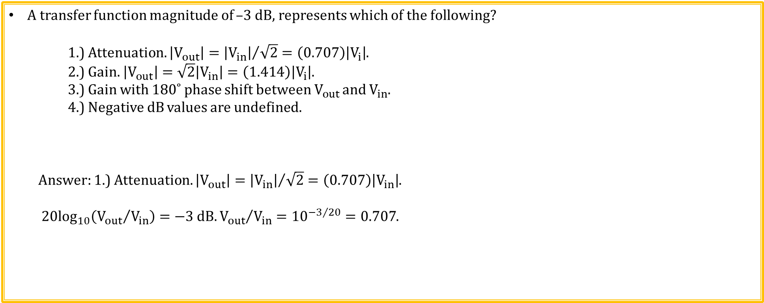
Frequency Response Test (Slide 2 of 5)
A transfer function magnitude of –3 dB, represents which of the following?
1.) Attenuation. $\left|V_{out}\right|={\left|V_{in}\right|}/{\sqrt{2}}=\left(0.707\right)\left|V_{i}\right|$.
2.) Gain. $\left|V_{out}\right|=\sqrt{2}\left|V_{in}\right|=\left(1.414\right)\left|V_{i}\right|$.
3.) Gain with 180˚ phase shift between $V_{out}$ and $V_{in}$.
4.) Negative dB values are undefined.
Answer: 1.) Attenuation. $\left|V_{out}\right|={\left|V_{in}\right|}/{\sqrt{2}}=\left(0.707\right)\left|V_{in}\right|$.
$20\log_{10}\left({V_{out}}/{V_{in}}\right)=−3 dB. {V_{out}}/{V_{in}}={10}^{{−3}/{20}}=0.707$.

Slide 32
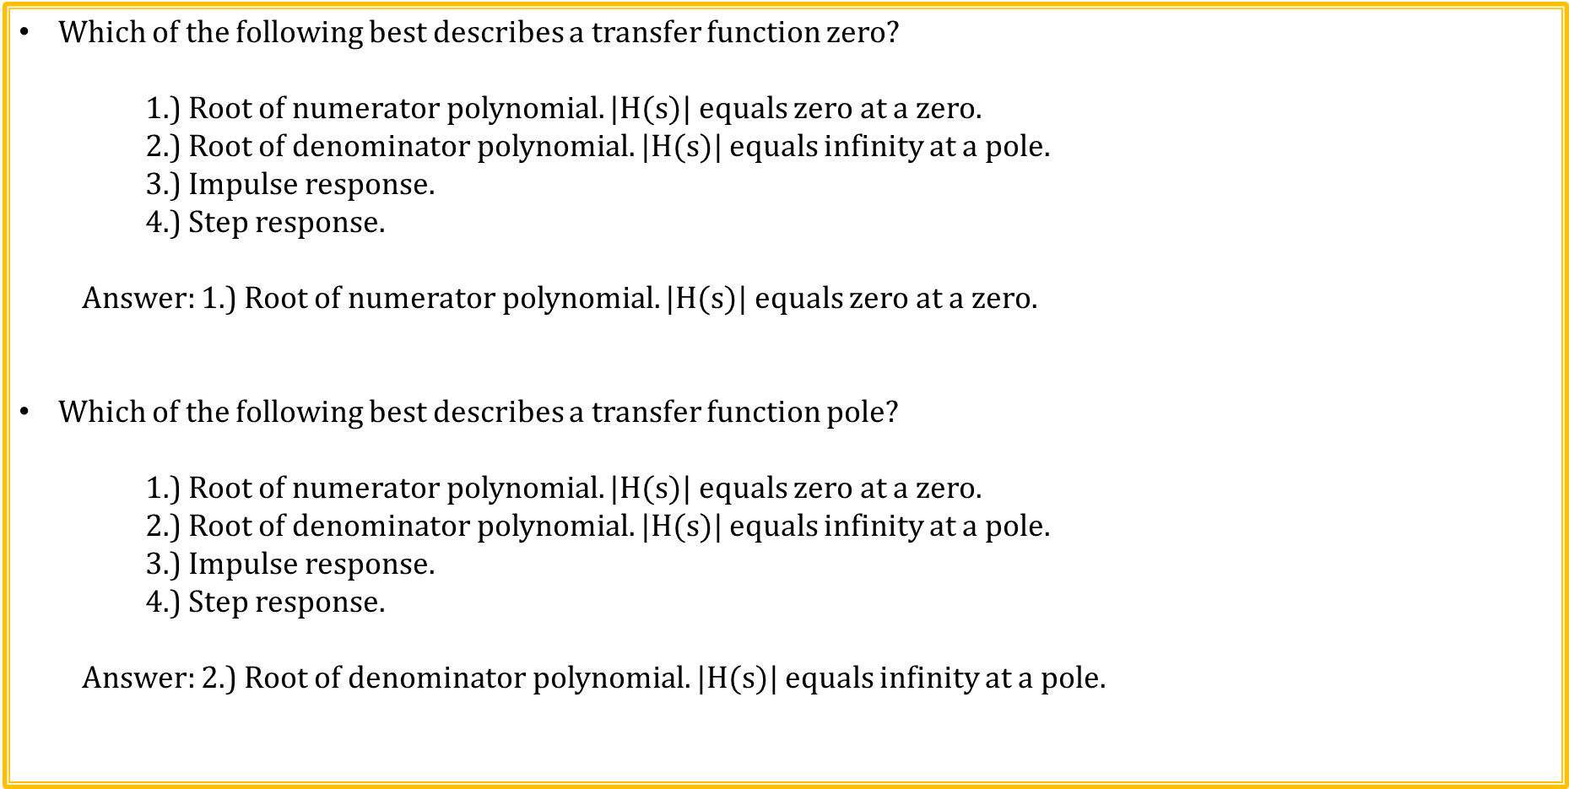
Frequency Response Test (Slide 3 of 5)
Which of the following best describes a transfer function zero?
1.) Root of numerator polynomial. |H($s$)| equals zero at a zero.
2.) Root of denominator polynomial. |H($s$)| equals infinity at a pole.
3.) Impulse response.
4.) Step response.
Answer: 1.) Root of numerator polynomial. |H($s$)| equals zero at a zero.
Which of the following best describes a transfer function pole?
1.) Root of numerator polynomial. |H($s$)| equals zero at a zero.
2.) Root of denominator polynomial. |H($s$)| equals infinity at a pole.
3.) Impulse response.
4.) Step response.
Answer: 2.) Root of denominator polynomial. |H($s$)| equals infinity at a pole.

Slide 33
Frequency Response Test (Slide 4 of 5)
Transmission zeros result in which of the following frequency response changes for increasing frequency beyond the zero frequency?
1.) More rapid increase in magnitude.
2.) More rapid decrease in magnitude.
3.) Zeros have no effect on the frequency response.
4.) Not enough information.
Answer: 1.) More rapid increase in magnitude.
Poles in the transfer function result in which of the following frequency response changes for increasing frequency beyond the pole frequency?
1.) More rapid increase in magnitude.
2.) More rapid decrease in magnitude.
3.) Poles have no effect on the frequency response.
4.) Not enough information.
Answer: 2.) More rapid decrease in magnitude.

Slide 34
Frequency Response Test (Slide 5 of 5)
Which of the following describes the frequency response of a linear system?
1.) Ratio of phasor output to the phasor input.
2.) Fourier Transform of the time domain impulse response.
3.) Laplace Transform of the time domain impulse response evaluated at s = jω.
4.) All of the above.
Answer: 4.) All of the above.
Any periodic waveform can be represented a series of sinusoids of various frequencies and magnitudes?
True.
False.
Answer: True. This is called the Fourier Series representation. For signals that are not periodic, the Fourier Transform can be used to arrive at the frequency content of the time domain signal.

Slide 35
Extra

